Slide 1
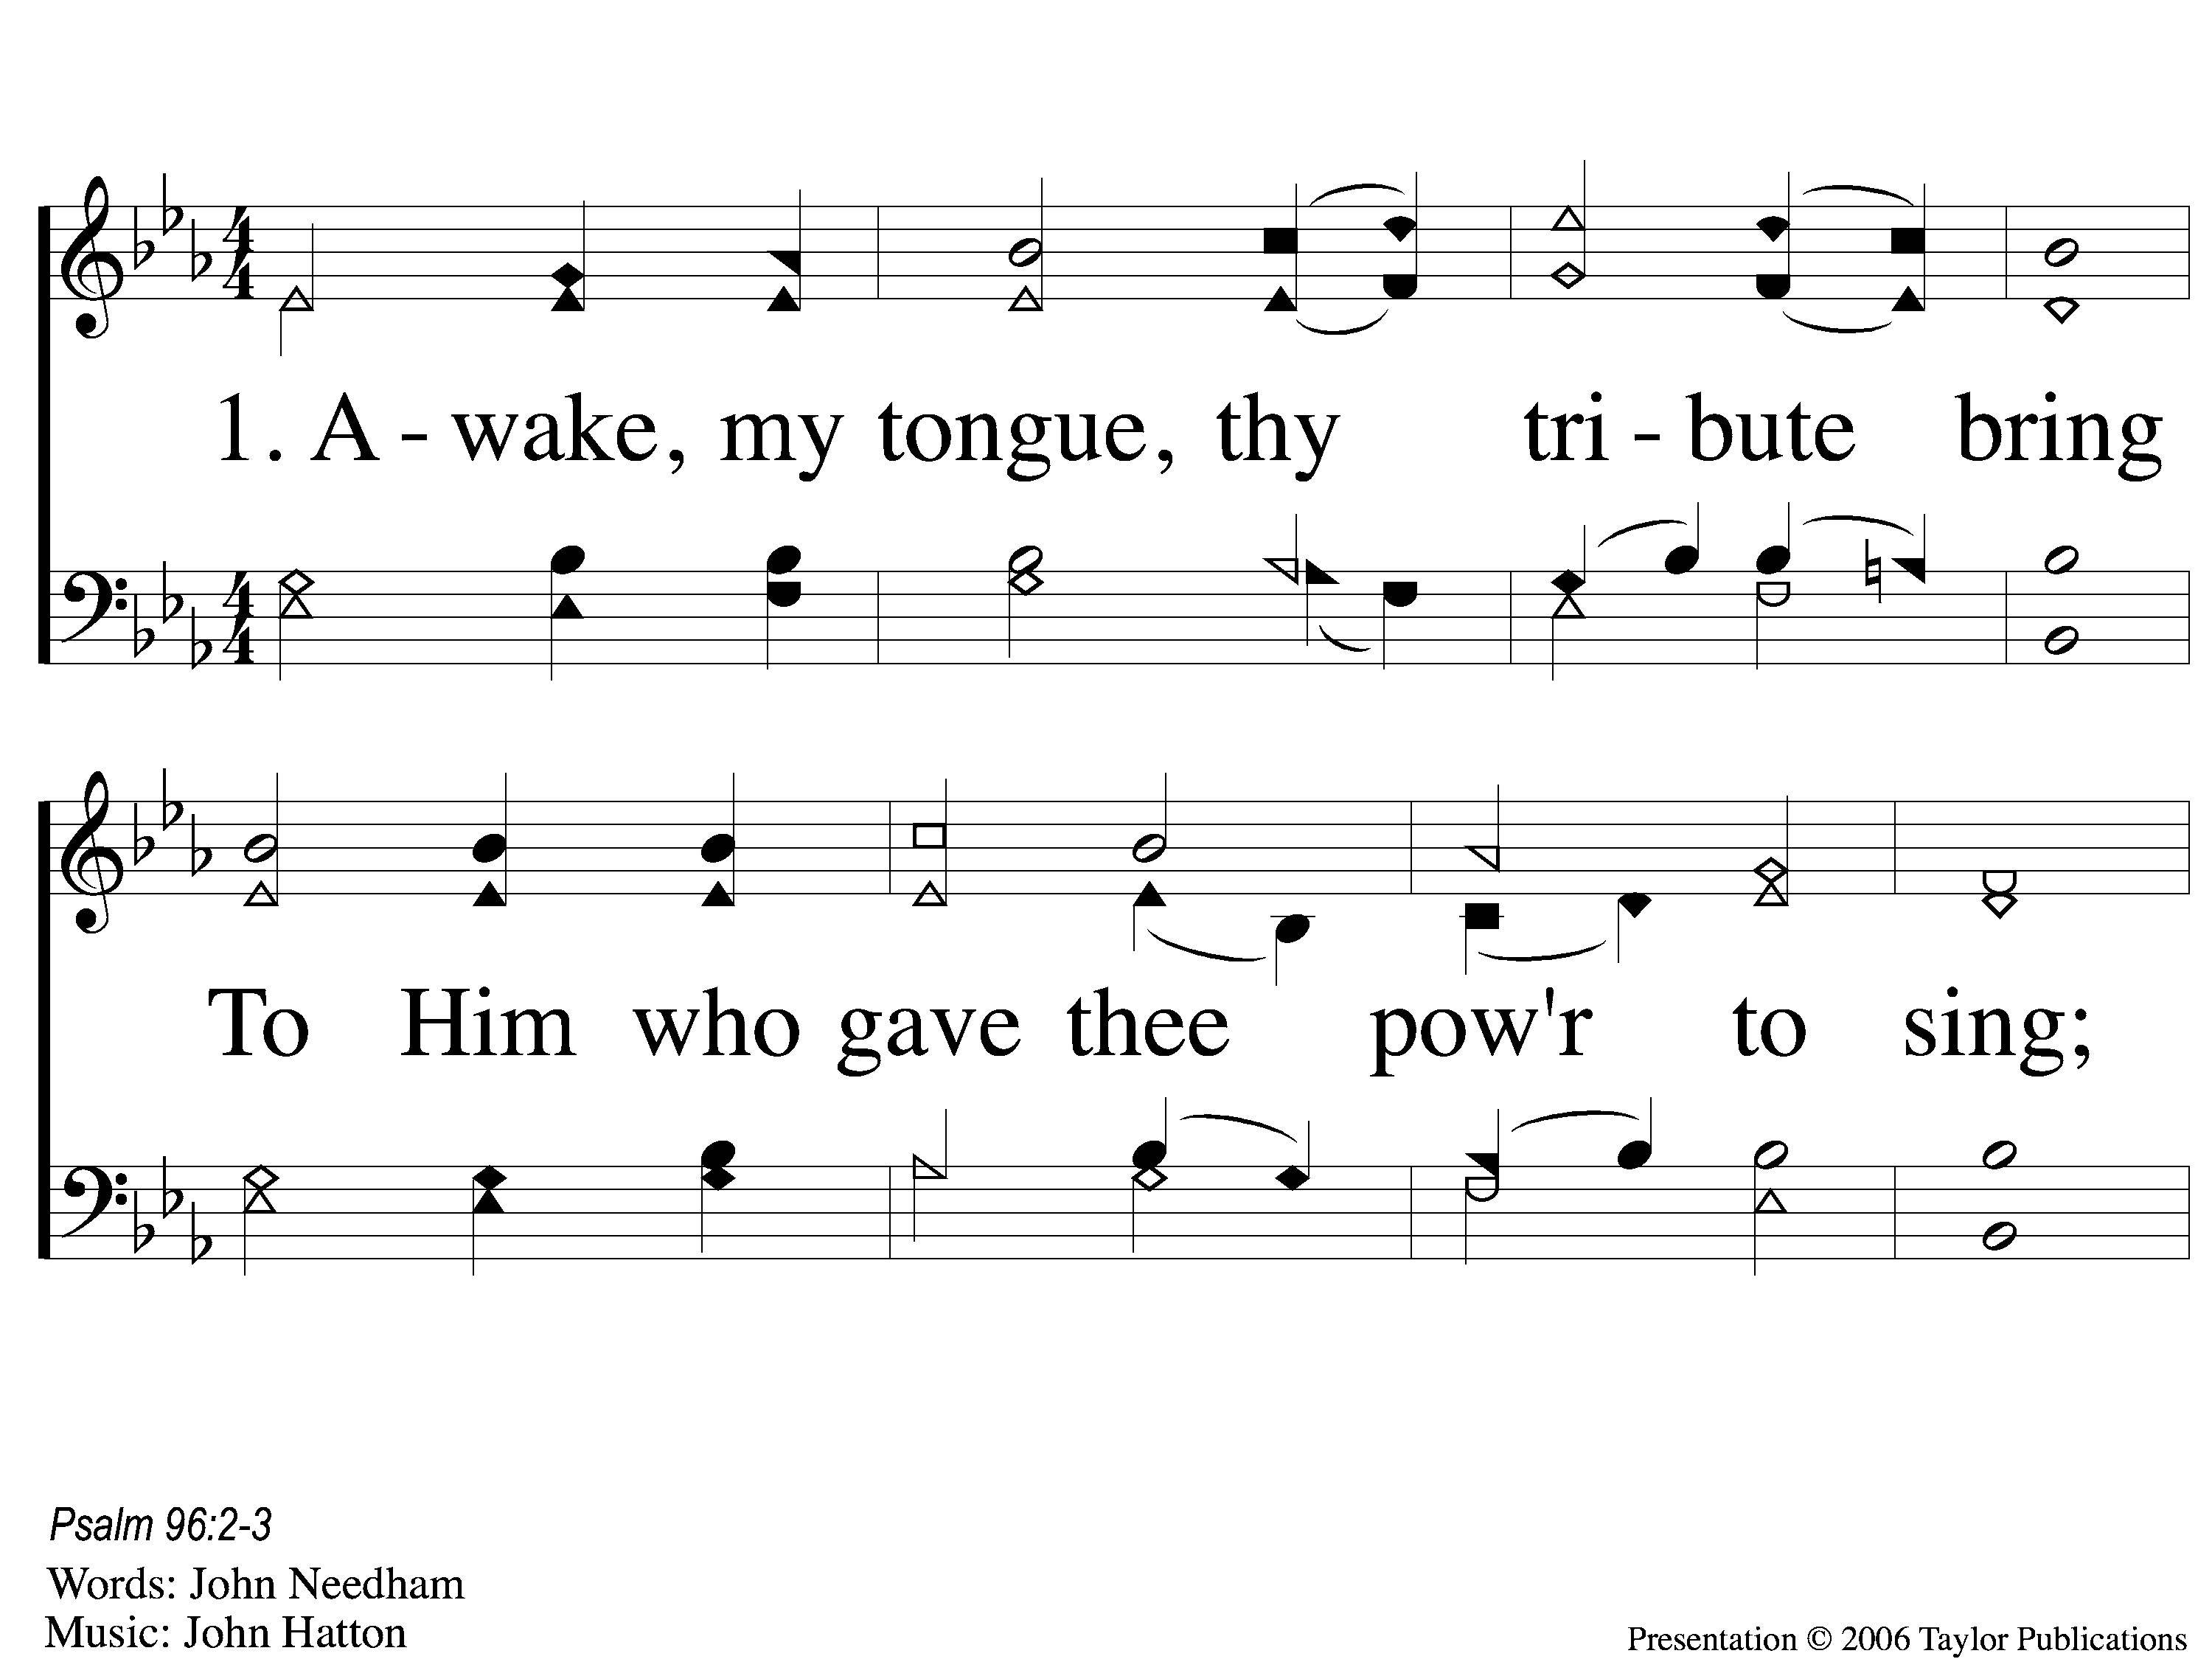
1-1 Awake My Tongue Thy Tribute Bring
Awake, My Tongue, Thy Tribute Bring
630

Slide 2
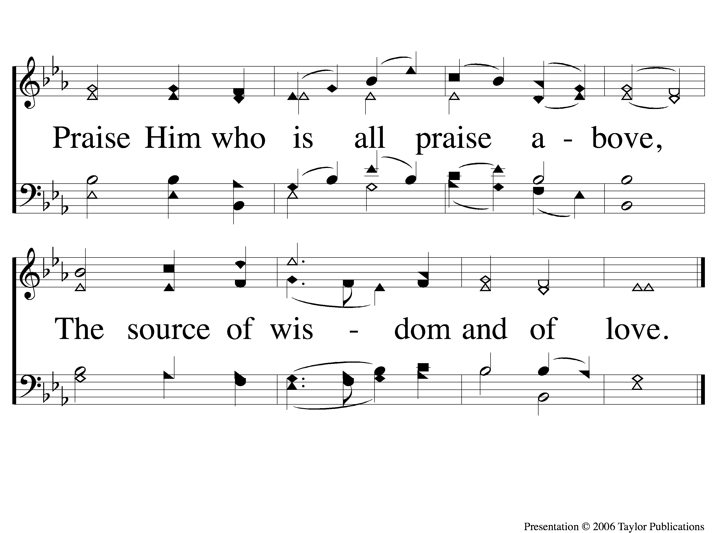
1-2 Awake My Tongue Thy Tribute Bring
Awake, My Tongue, Thy Tribute Bring
630

Slide 3
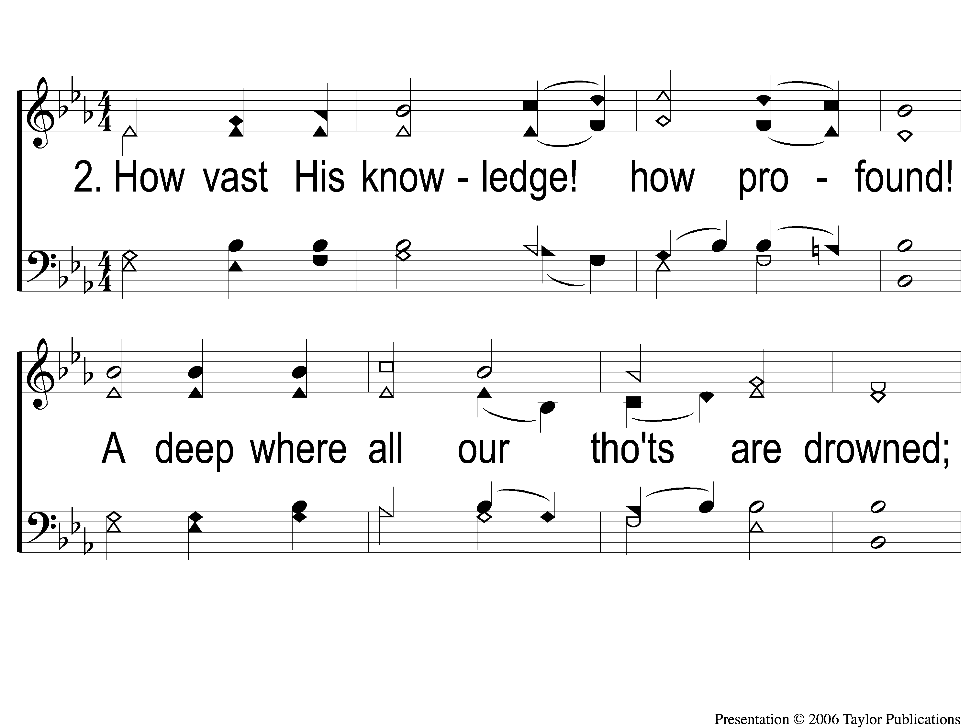
2-1 Awake My Tongue Thy Tribute Bring
Awake, My Tongue, Thy Tribute Bring
630

Slide 4
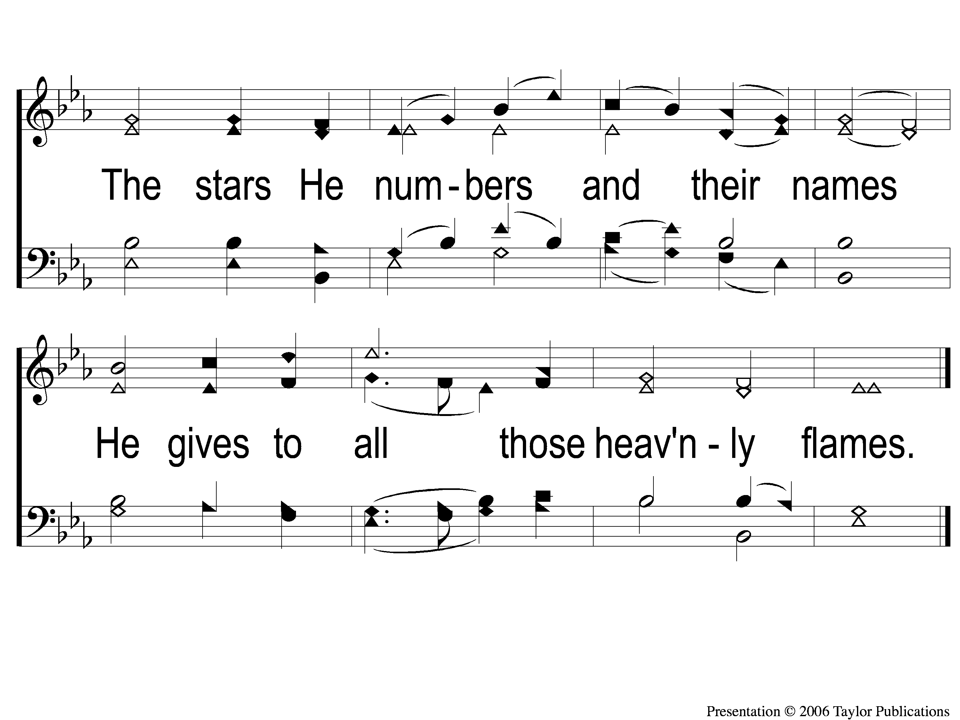
2-2 Awake My Tongue Thy Tribute Bring
Awake, My Tongue, Thy Tribute Bring
630

